Slide 1

Insurance Price Prediction Case Study

Slide 2
Problem Statement
Insurance companies need to accurately predict the cost of health insurance for individuals to set premiums appropriately. However, traditional methods of cost prediction often rely on broad actuarial tables and historical averages, which may not account for the nuanced differences among individuals. By leveraging machine learning techniques, insurers can predict more accurately the insurance costs tailored to individual profiles, leading to more competitive pricing and better risk management.

Slide 3
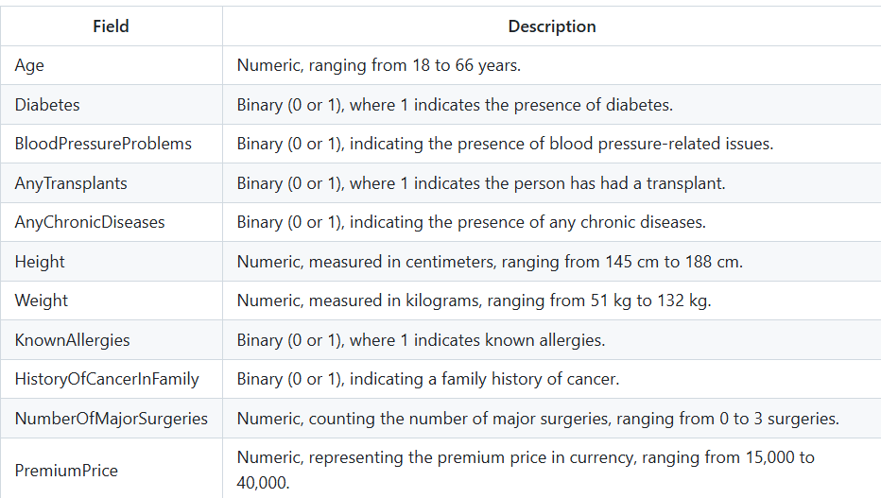
Data Description

Slide 4
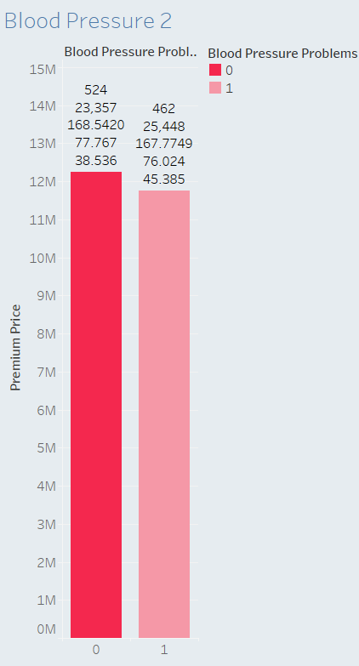
Key Insights from Data Analysis
Analyzing the data revealed various factors affecting insurance premiums:
Health Conditions and Premium Variations
Insight: Blood pressure appears to be a significant factor, raising premiums by about 2,000. This increase reflects the added risk insurers associate with hypertension, which can lead to more frequent health complications.
Blood Pressure
Without Blood Pressure Problems: On average, applicants without blood pressure issues pay a premium of 23,357. The average age of these individuals is 38.5, with a mean weight of 77.76 kg and height of 168.5 cm. This group consists of 524 individuals.
With Blood Pressure Problems: The average premium rises to 25,448 for those with blood pressure issues, with an average age of 45.39, weight of 76 kg, and height of 167.77 cm. There are 462 applicants in this category.

Slide 5
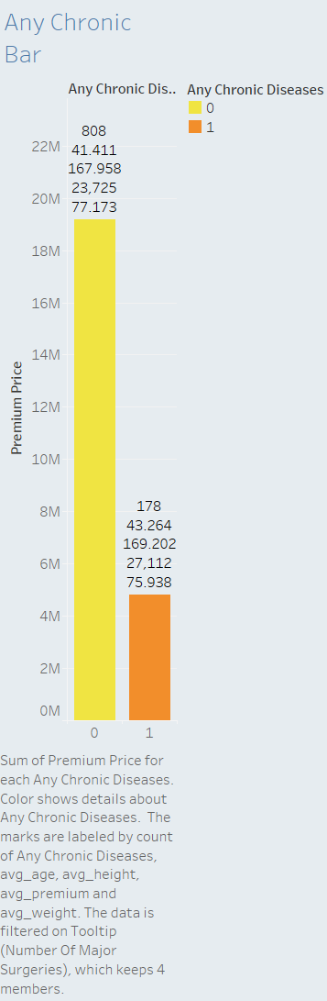
2. Chronic Diseases
No Chronic Diseases: Individuals without chronic diseases have an average premium of 23,725. Their average age is 41.41, with a weight of 77.17 kg and height of 168 cm. This group has 808 members.
With Chronic Diseases: Premiums increase to 27,112 for those with chronic conditions, with an average age of 43.26, weight of 76 kg, and height of 169.2 cm. This group has 178 applicants.
Insight: A higher premium for individuals with chronic diseases is expected, given the increased likelihood of requiring medical care. Approximately 80% of applicants do not have chronic diseases, suggesting that chronic illness impacts a smaller portion of the pool but significantly influences their premium costs.

Slide 6
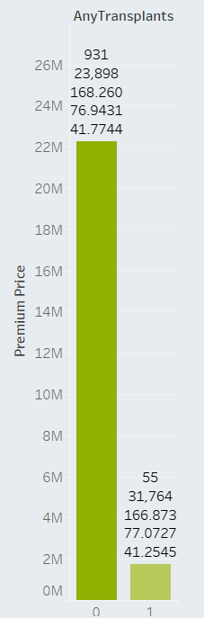
3. Organ Transplants
No Transplants: Applicants without a transplant history pay an average premium of 23,898, with an average age of 41.77 years, weight of 76.94 kg, and height of 168.26 cm. This group has 931 individuals.
With Transplants: The average premium jumps to 31,764 for those who have undergone a transplant, with an average age of 41.25, weight of 77.07 kg, and height of 166.87 cm. This smaller group comprises 55 applicants.
Insight: Transplants increase premiums by a notable margin. The high cost likely reflects the need for ongoing medical monitoring, medication, and higher health risks associated with organ transplants.

Slide 7
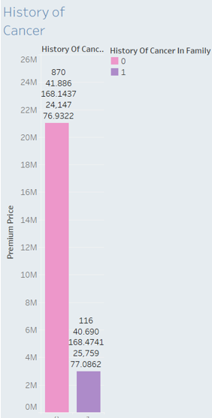
4. History of Cancer
No Cancer History: The average premium for applicants without cancer history is 24,147, with an average age of 41.88 years, weight of 76.93 kg, and height of 168.14 cm. There are 870 individuals in this category.
With Cancer History: Those with a cancer history face a higher premium of 25,759, with an average age of 40.69, weight of 77.08 kg, and height of 168.47 cm. This group includes 116 individuals.
Insight: Cancer history increases premiums, though not as dramatically as other factors. With approximately 87% of applicants without a history of cancer, it remains a lower risk across the pool.

Slide 8
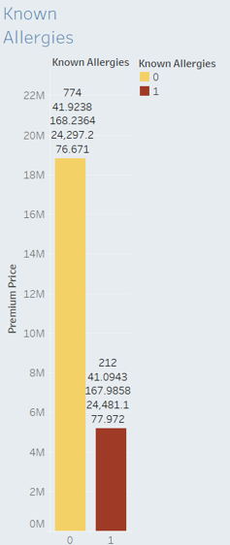
5. Known Allergies
Without Known Allergies: This group has an average premium of 24,297, with an average age of 41.92, weight of 76.67 kg, and height of 168.23 cm, totaling 774 individuals.
With Known Allergies: Premiums rise slightly to 24,481 for applicants with allergies, with an average age of 41.09, weight of 78 kg, and height of 168 cm. This group has 212 individuals.
Insight: Allergies contribute minimally to premium increases, reflecting a relatively low risk to insurers.

Slide 9
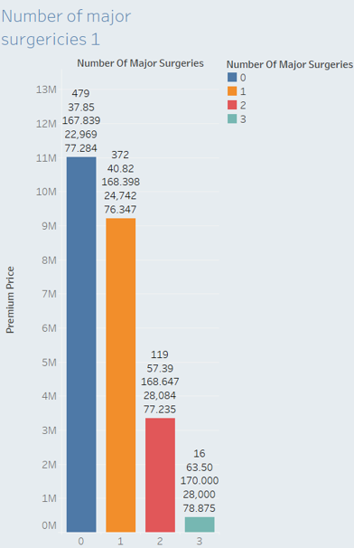
Number of Major Surgeries: As the number of surgery increases the number of people purchasing the premium also decreases. The premium purchased by people without any surgery is ₹22,969 as the number of surgery increases the average premium of the insurance being purchased increases.
As the number of surgeries increases, the premium rises as well. For example:
No surgeries: 22,969
One surgery: 24,742
Two surgeries: 28,084
Three surgeries: 28,000
Insight: The correlation between surgeries and premium cost reflects insurers’ view of surgical history as an indicator of higher risk.

Slide 10
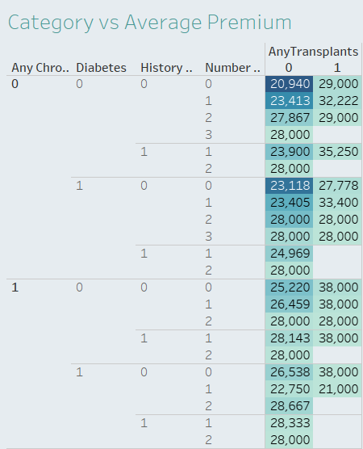
Categorical Columns vs Average Premium
Premiums are high wen the there are chronic Diseases and Organ transplant
Notes:
From the heatmap we could understand the average premium for various combination of the categories. From the above we could infer category like Chronic disease and transplant have higher impact on the increase of premium paid being paid by the insurance purchaser.
These findings underscore how certain health conditions result in higher premiums, with chronic diseases and organ transplants having a significant impact.

Slide 11
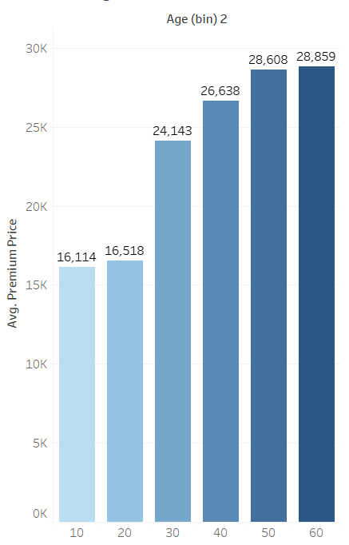
Demographic Factors and Their Influence
Age Distribution: The premium cost generally rises with age:
Ages 18–20: 16,114
Ages 20–30: 16,518
Ages 30–40: 24,143
Ages 40–50: 26,638
Ages 50–60: 28,608
Ages 60–65: 28,859
Insight: Younger individuals benefit from lower premiums, reflecting a reduced likelihood of medical issues. This trend encourages early insurance enrolment, providing long-term savings.
Notes:
Younger policyholders pay lower premiums. For example, individuals aged 18–20 pay an average of ₹16,114, while those aged 60–65 pay around ₹28,859. This reflects increased health risks as age advances.

Slide 12
Body Mass Index (BMI):
Average Premium by BMI Category:
Underweight: 22,667
Normal: 23,756
Overweight: 24,237
Obese: 25,238
link for Tableau visualization
https://public.tableau.com/views/Insurancepriceprediction_Arivalagan_2/ICPDashboard1?:language=en-US&publish=yes&:sid=&:redirect=auth&:display_count=n&:origin=viz_share_link
2. https://public.tableau.com/shared/6G69RBR3N?:display_count=n&:origin=viz_share_link
Notes:
BMI was categorized as underweight, normal weight, overweight, and obese, with average premiums increasing across these categories. Obese individuals pay an average premium of ₹25,237, which is higher than other categories.

Slide 13
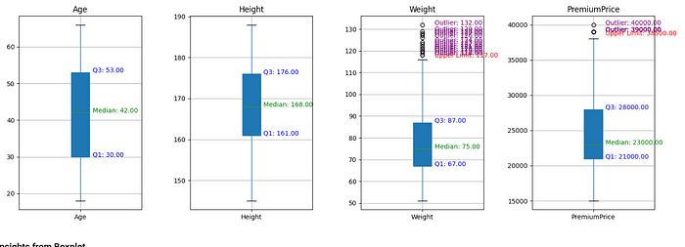
Distribution Insights From Visualizations
Boxplot Analysis: Most insurance buyers are between 30 and 53 years old. Heights and weights largely fall within expected ranges, although weight shows outliers. Premiums range from 21,000 to 28,000, with minimal outliers.

Slide 14
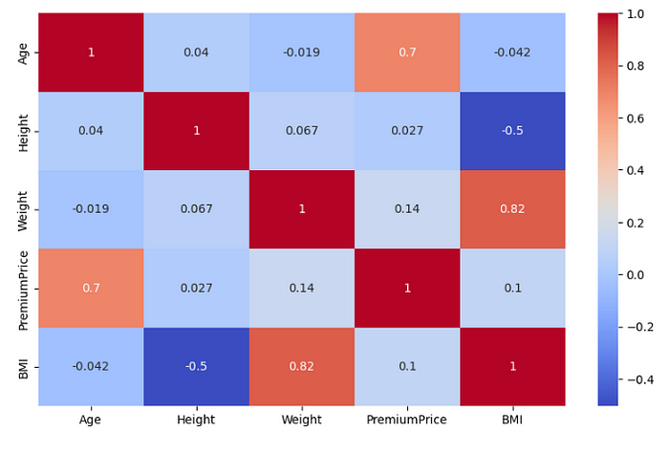
Correlation Plot: Age correlates positively with premium cost, while BMI is closely linked with weight. We drop weight in regression models due to multicollinearity.

Slide 15
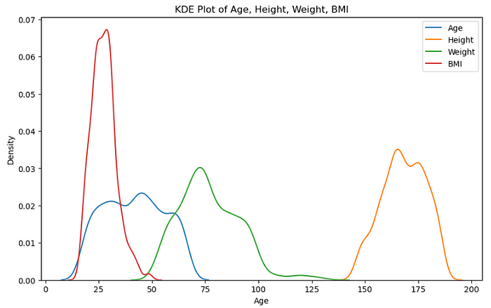
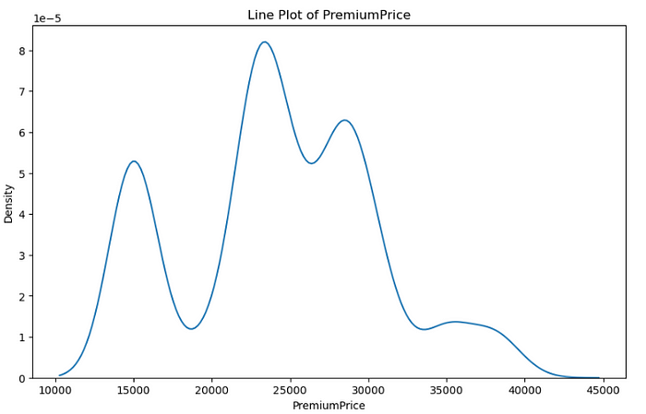
Scatter Plots and KDE: Age distribution shows near-normality; other features are skewed. A normalizing transformation may help improve model accuracy.

Slide 16
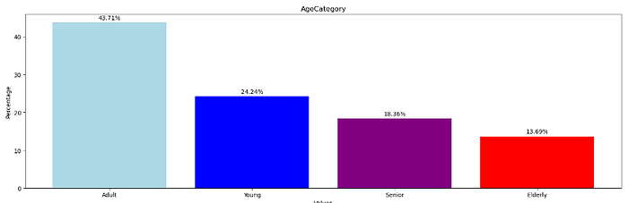
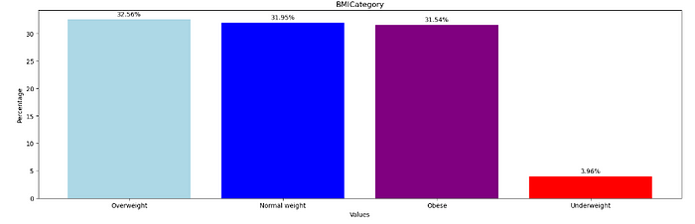
Age Category:
44 percentage of the policy purchaser are adults, followed by 24 percentage of young people, 18.4% are seniors and 13.7% Elderly.
BMI Category:
32.5% insurance purchaser are overweight, 31.95% are under normal weight, 31.54% are Obese and 3.96% are Underweight.

Slide 17
Hypothesis Testing
T-test:
Diabetes:
Average premium price for individuals without Diabetes: ₹23,931.82
Average premium price for individuals with Diabetes: ₹24,896.14
p-value: 0.0167
Blood Pressure Problems:
Average premium price for individuals without Blood Pressure Problems: ₹23,356.87
Average premium price for individuals with Blood Pressure Problems: ₹25,448.05
p-value: 1.31e-07
Any Transplants:
Average premium price for individuals without Transplants: ₹23,897.96
Average premium price for individuals with Transplants: ₹31,763.64
p-value: 1.98e-20
Any Chronic Diseases:
Average premium price for individuals without Chronic Diseases: ₹23,725.25
Average premium price for individuals with Chronic Diseases: ₹27,112.36
p-value: 3.71e-11
Known Allergies:
Average premium price for individuals without Known Allergies: ₹24,297.16
Average premium price for individuals with Known Allergies: ₹24,481.13
p-value: 0.7043
History of Cancer in Family:
Average premium price for individuals without History of Cancer in Family: ₹24,147.13
Average premium price for individuals with History of Cancer in Family: ₹25,758.62
p-value: 0.0090
Notes:
T-test:
We will perform hypothesis testing on binary categorical columns ‘Diabetes’, ‘BloodPressureProblems’, ‘AnyTransplants’, ‘AnyChronicDiseases’, ‘KnownAllergies’, ‘HistoryOfCancerInFamily’ with respect to Premium price column. The default Null hypothesis is both group have same average premium price and the alternate hypothesis will be both the groups have different average premium. Average premium price for all the binary categorical columns are different.
Based on the t-test results, we can draw several conclusions regarding the average premium prices for various health conditions:
Since the p-value is less than 0.05, we reject the null hypothesis, suggesting a significant difference in premium prices for individuals with and without Diabetes.
The p-value is extremely low, leading us to reject the null hypothesis. This indicates a significant difference in premium prices between those with and without Blood Pressure Problems.
With a very low p-value, we reject the null hypothesis. This confirms a significant disparity in premium prices for individuals with and without Transplants.

Slide 18
Chi-Square test:
Significant Associations:
Blood Pressure Problems with Number of Major Surgeries and Age Category.
Any Chronic Diseases with Age Category.
Known Allergies with History of Cancer in Family and Number of Major Surgeries.
History of Cancer in Family with Number of Major Surgeries.
Number of Major Surgeries with Age Category.
No Significant Associations:
Blood Pressure Problems with BMI Category.
Any Transplants with Any Chronic Diseases, Known Allergies, History of Cancer in Family, Number of Major Surgeries, Age Category, and BMI Category.
Any Chronic Diseases with Known Allergies, History of Cancer in Family, Number of Major Surgeries, and BMI Category.
Known Allergies with Age Category and BMI Category.
History of Cancer in Family with Age Category and BMI Category.
Number of Major Surgeries with BMI Category.
Age Category with BMI Category.
Notes:
These results highlight key relationships and independence between various health conditions and demographics.

Slide 19
Model Building
Data Preprocessing
Scaling: Min-max scaling on non-normally distributed features.
Feature Selection: Exclude features with high multicollinearity (e.g., weight) to improve model stability.

Slide 20
Model Comparisons for Health Insurance Premium Prediction
Linear Regression Model:
Initial Performance:
Mean Absolute Error (MAE): 2,602, indicating an average prediction error of this amount, suggesting moderate predictive accuracy.
Mean Squared Error (MSE): 12,278,380, revealing that larger errors occur in some predictions, which skews the MSE higher.
R² Score: 0.71, showing that 71% of the variance in premium prices is explained by this model.

Slide 21
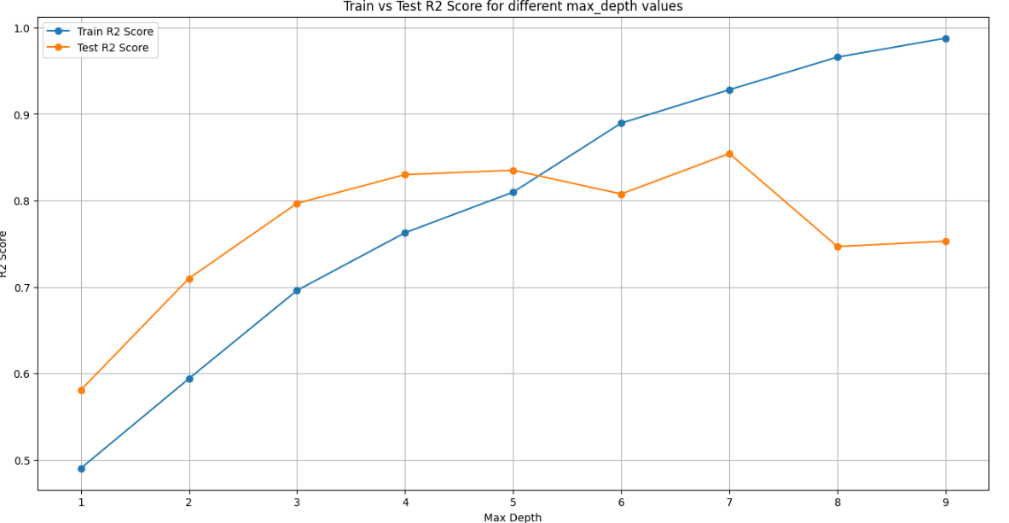
Decision Tree Regressor:
Initial Performance:
R² Score: 0.60, indicating moderate predictive accuracy without tuning.
Tuned Performance:
With max depth set to 5, the model achieved Train Score: 80.96% and Test Score: 83.5%, showing improved prediction accuracy and reduced overfitting.
Feature Importance:
Key predictors included Age and AnyTransplants, aligning with Linear Regression in identifying these as top factors influencing premium predictions.

Slide 22
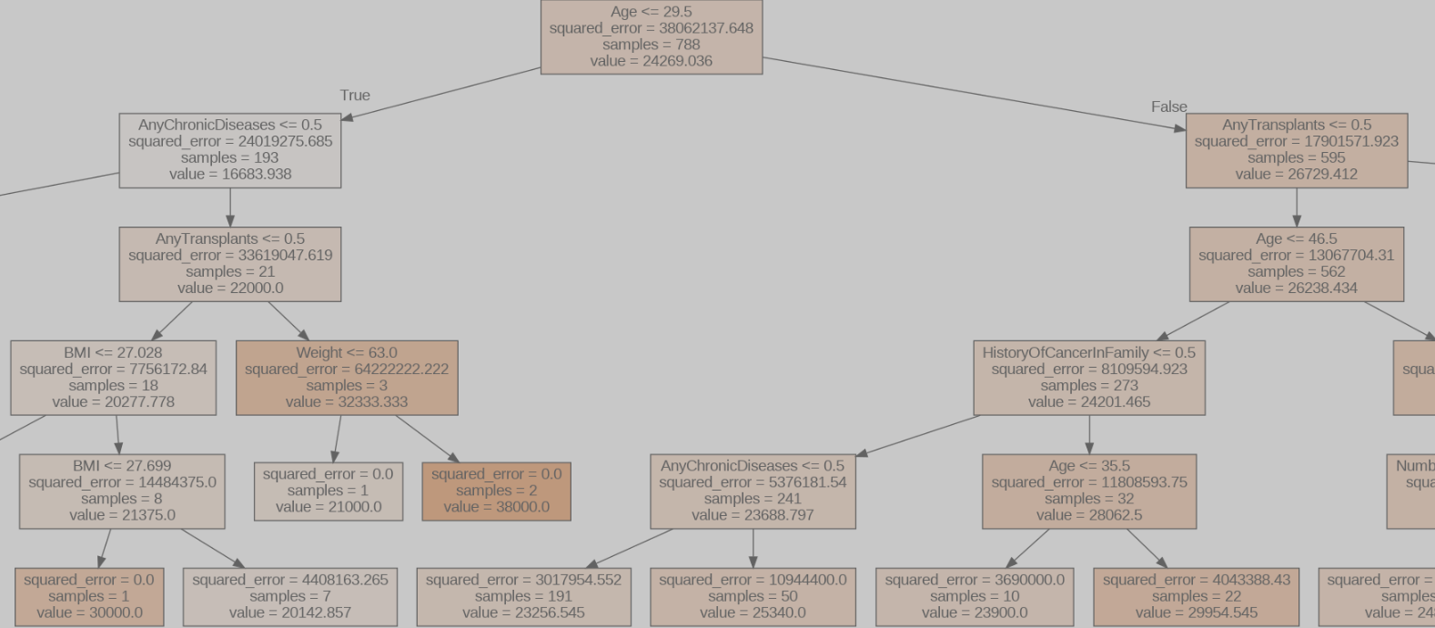
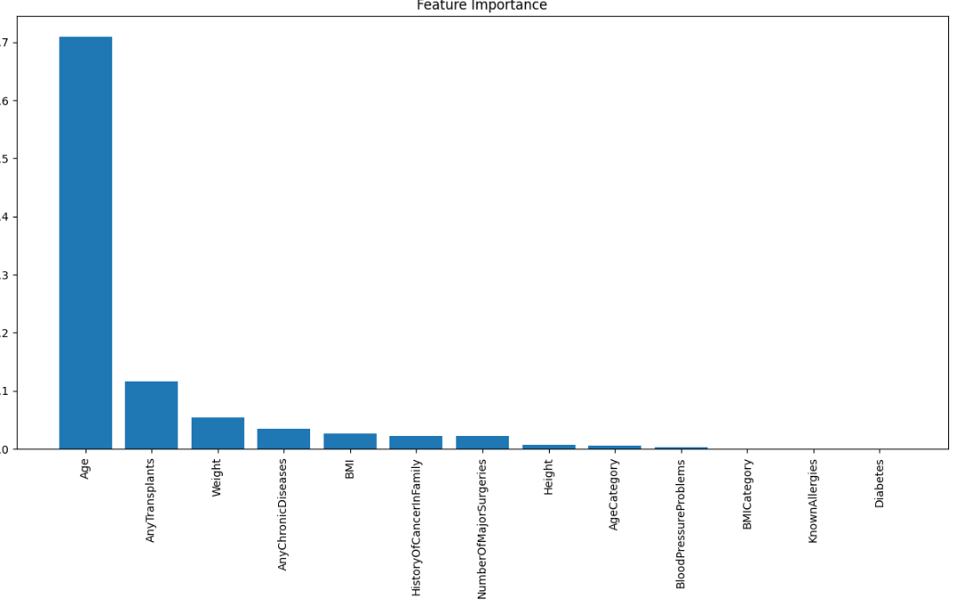

Slide 23
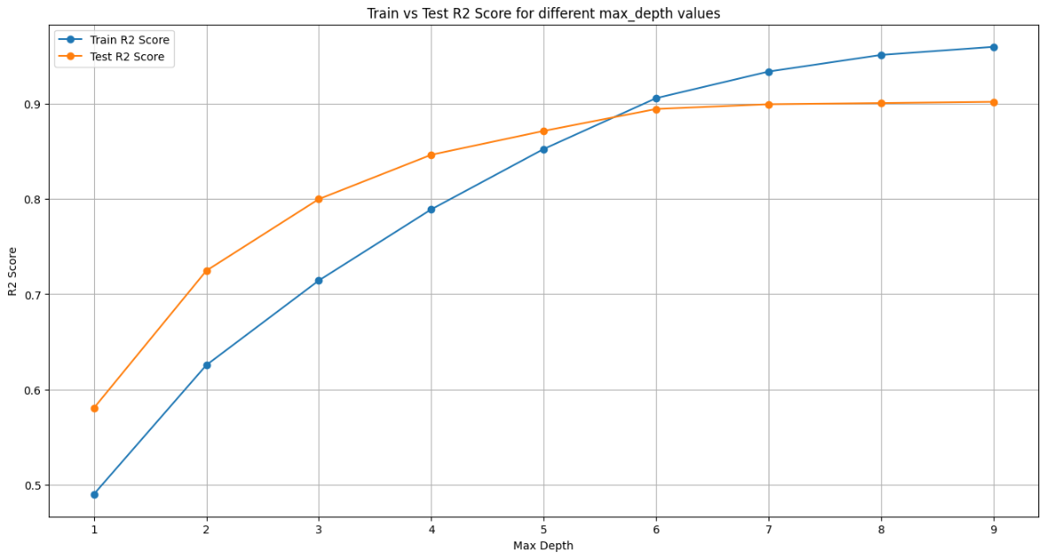
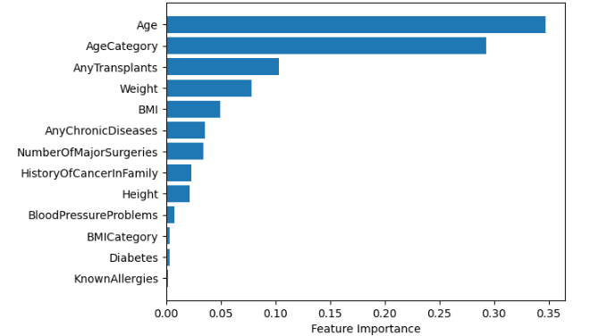
Random Forest Regressor:
Performance:
R² Score: 0.90 after tuning, demonstrating strong predictive capabilities.
Cross-Validated R² Scores: Displayed robust stability, ranging from 0.68 to 0.90, further confirming generalizability.
Train and Test Scores: Achieved Train Score: 93.36% and Test Score: 89.93% at max depth 7, striking a balance between accuracy and overfitting.
Optimal Depth Selection:
Max depth of 7 yielded the best fit, providing a combination of high accuracy and interpretability. The Random Forest model was selected as a primary model for final predictions due to its high performance and feature interpretability.

Slide 24
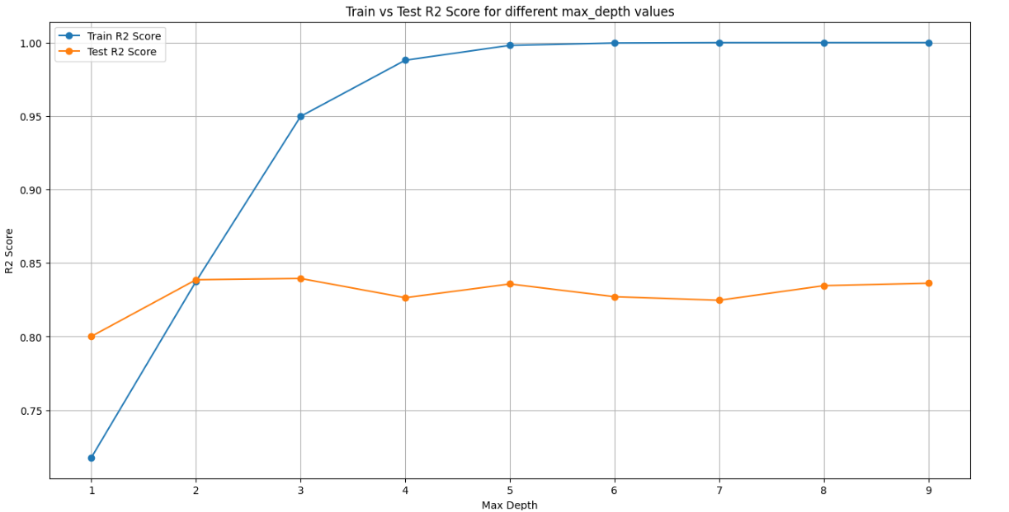
XGBoost Regressor:
Performance:
R² Score: 0.84, with indications of overfitting as the Train R² Score reached 100%.
Optimal Depth: Set to a max depth of 2 to mitigate overfitting, resulting in a balanced Train Accuracy: 83.75% and Test Accuracy: 83.87%.
XGBoost, while slightly lower-performing than Random Forest, still provides strong predictions and is efficient in capturing subtle patterns in the dataset.

Slide 25
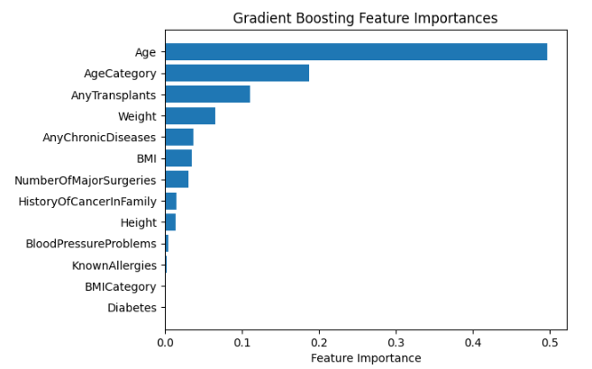
Gradient Boosting Model:
Performance:
R² Score: 0.87, with cross-validated R² scores indicating consistent performance across folds.
Train Score: 89% and Test Score: 87%, showing high accuracy with slightly lower test accuracy compared to Random Forest and LightGBM.
Conclusion:
Gradient Boosting, along with Random Forest and LightGBM, was included in the final model ensemble to provide robust predictions.

Slide 26
Final Model Selection: Based on high R² scores and stability, Random Forest Regressor, Gradient Boosting, and LightGBM were chosen for final predictions. Their combined ensemble output will provide reliable premium price predictions with reduced variance, capturing intricate feature interactions effectively.

Slide 27
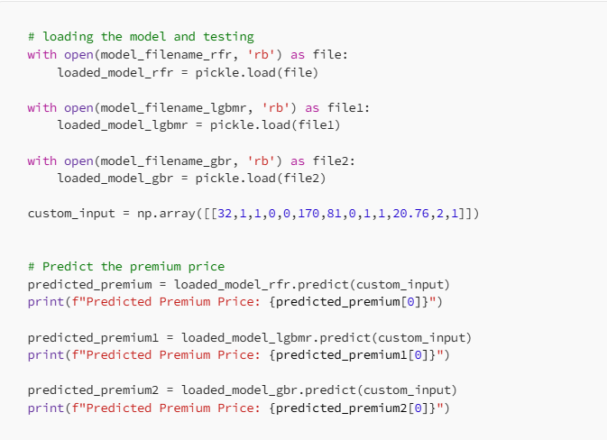
Model testing
Predicted Premium Price of RFR: 24068.58543417367
Predicted Premium Price of LightGBR: 25596.105973635214
Predicted Premium Price GBR: 24510.51622529958

Slide 28
Model Deployment
We will use streamlit for model deployment.
We will create requirement documents with the packages streamlit, scikit-learn, numpy, pandas and setuptools.
We create a python file for the basic front end integrate the model built and provide the input.
Then we deploy the app using streamlit server, Please access the app using the below link https://insurancepricepredictormodel-nbxnkjq6i5xm4mcqdshiyn.streamlit.app/
Fill up the necessary information after opening the link and click Predict Premium Price the app predict the premium price.

Slide 29
Recommendations:
With the findings from data analysis and model insights, here are some actionable recommendations for insurance companies:
Target Healthier Applicants: A significant portion (50%) of applicants does not report major health issues, suggesting a stable premium segment. Encouraging younger, healthier individuals to purchase insurance could increase customer retention and reduce risk.
Adjust Premiums Based on Transplants: Individuals with organ transplants bear significantly higher premiums. Implementing a dynamic premium adjustment could help insurers manage the risk associated with transplants better.
Focus on High-Risk Age Groups: Targeting age segments with higher premiums, particularly individuals over 50, could optimize insurance offerings. Discounts for early purchase (e.g., ages 18–30) might also encourage long-term policy uptake.
BMI-Linked Premium Adjustments: Since BMI influences premium amounts, insurers could adopt tiered premiums based on weight categories, rewarding healthier lifestyles.
By refining these strategies, insurance companies can offer more personalized and accurate premium rates, ensuring both profitability and customer satisfaction.

Slide 30
Conclusion
The insurance price prediction model effectively predict premium prices. By leveraging robust models and adjusting premiums based on health and demographic factors, insurance companies can create a more efficient and data-driven pricing strategy.

Slide 31
Thank YOU

